Slide 1

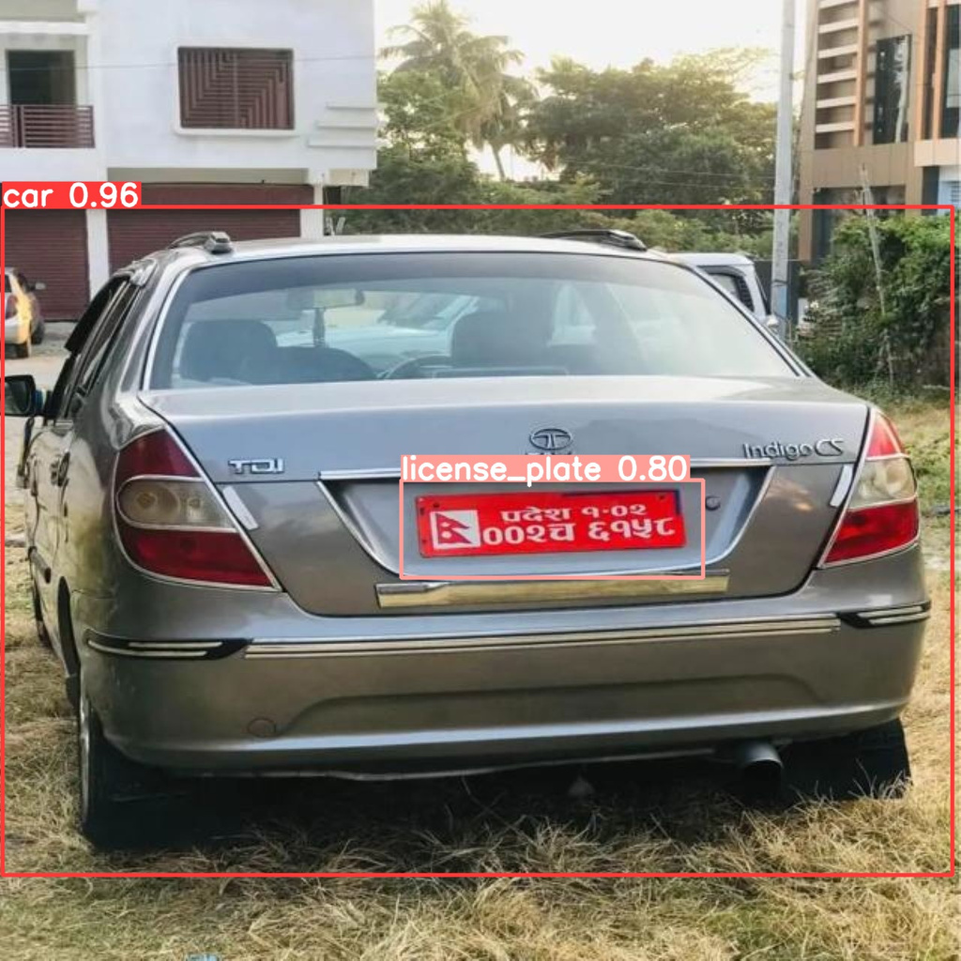
NEPALI NUMBER PLATE
DETECTION AND
RECOGNITION
Project Members:
Khushilal Mahato
Kshitiz Gajurel
Manish Kathet
Manoj Baniya

Slide 2
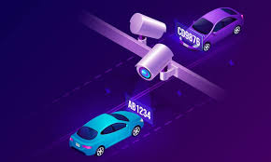
INTRODUCTION
Automatic Number Plate Recognition (ANPR) is a system capable of reading vehicle number plates without human intervention

Slide 3
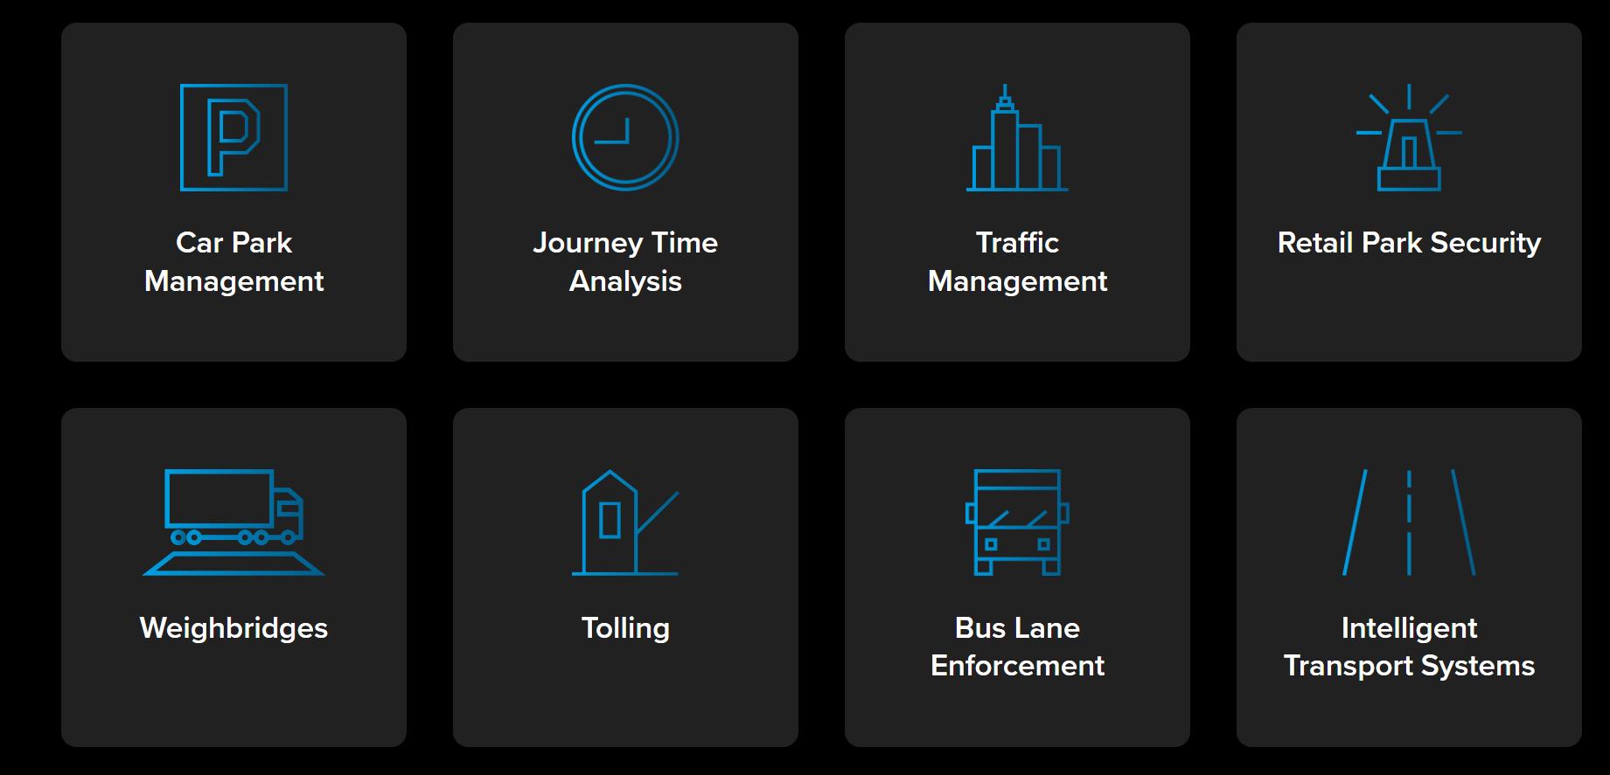
USE CASES

Slide 4
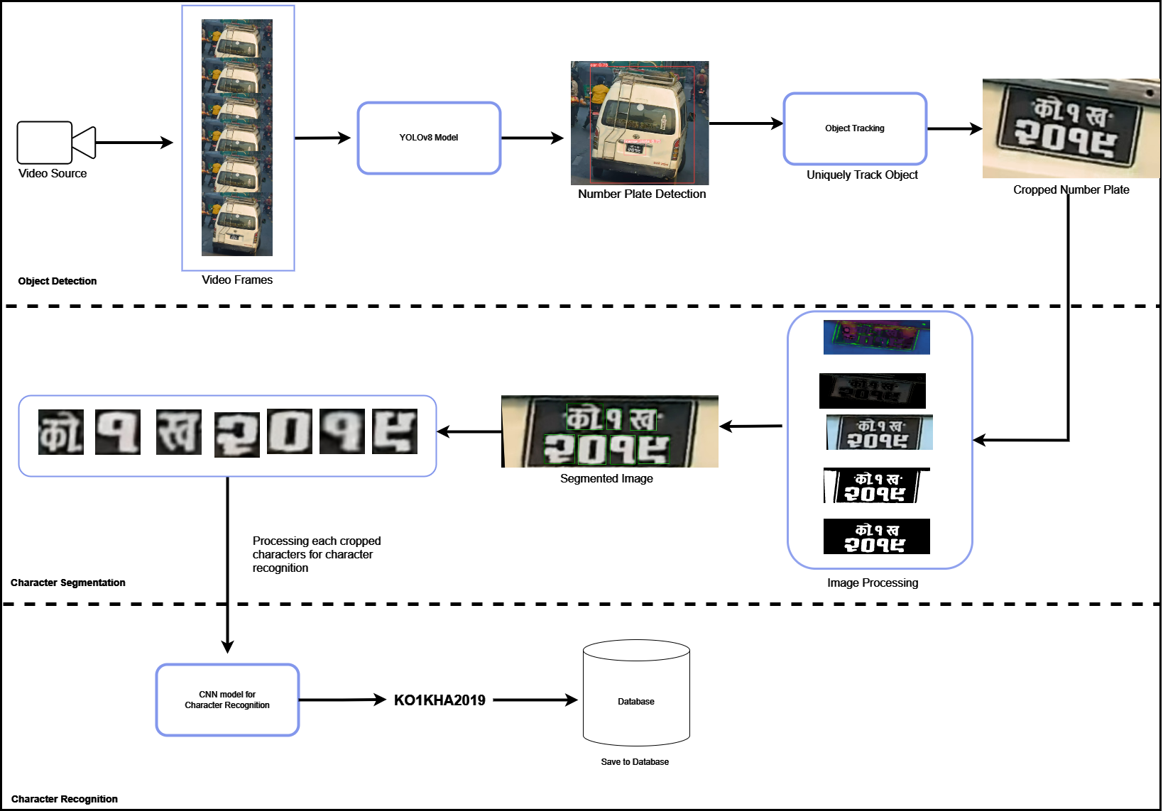

Slide 5
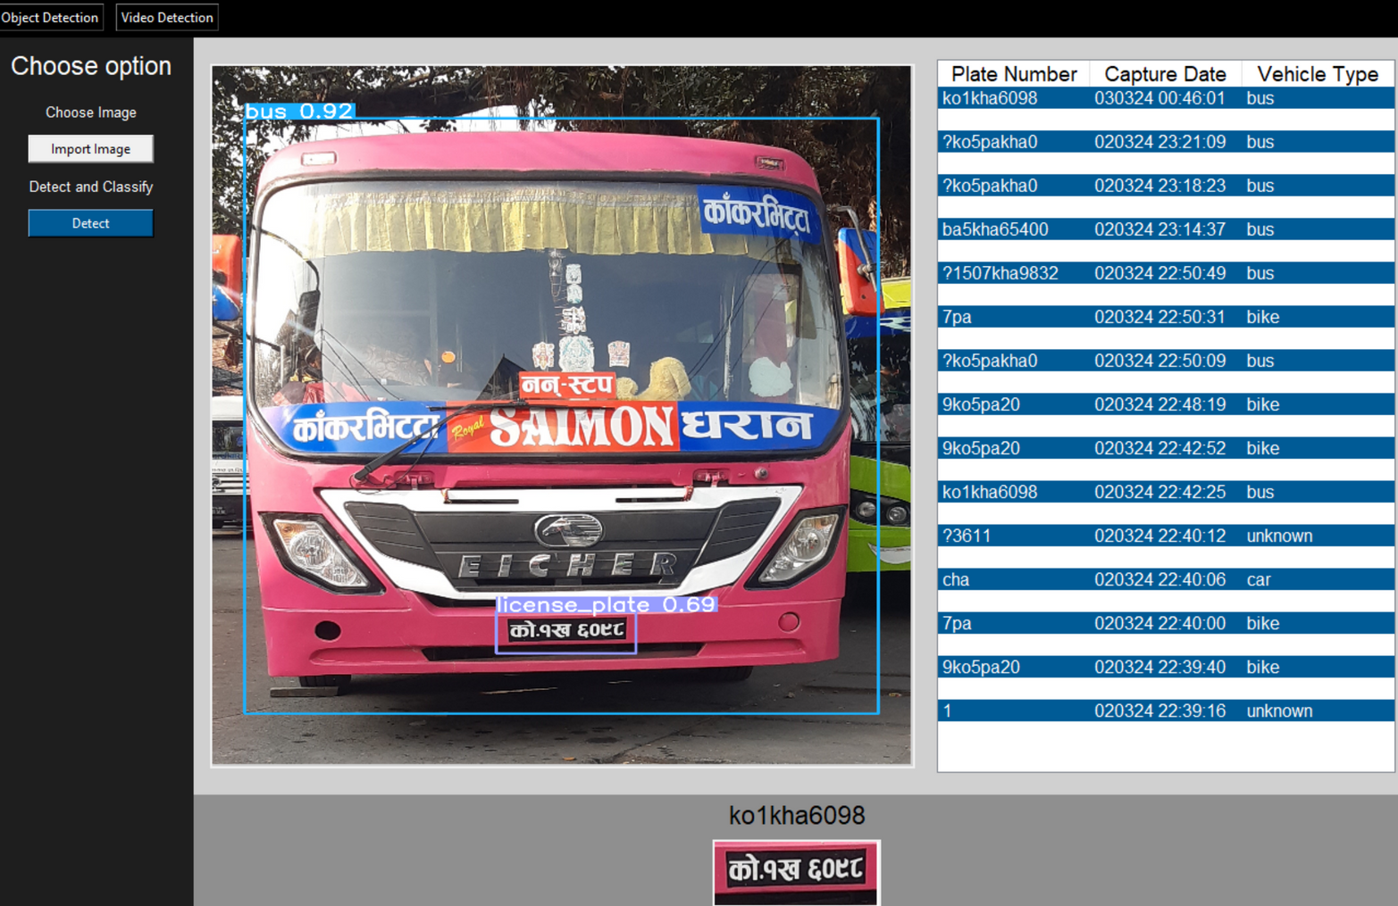
USER INTERFACE

Slide 6
TOOLS USED:
1. Python for Model Building:
Some popular libraries are used like:
- OpenCV
- Tensorflow
- Ultralytics YOLOv8
2. Tkinter for UI
3. SQLITE for database

Slide 7
Demo!

